Slide 1
More Machine Learning in Python
By Viktor Reichert

Slide 2
Working with unbalanced Data
There are several methods to deal with unbalanced data:
Collect more data of the minority class
Changing Weights of Lossfunction / use penalized models
Oversampling
Undersampling
Synthetic Othersampling

Slide 3
Correct scoring!
Accuracy should not be used for unbalanced Data!
There are different indicators derivable form a confusion matrix:
F1
Recall
Precision

Slide 4
SMOTE (Synthetic Minority Oversampling Thechnique)
Create new „synthetic“ Observations

Slide 5
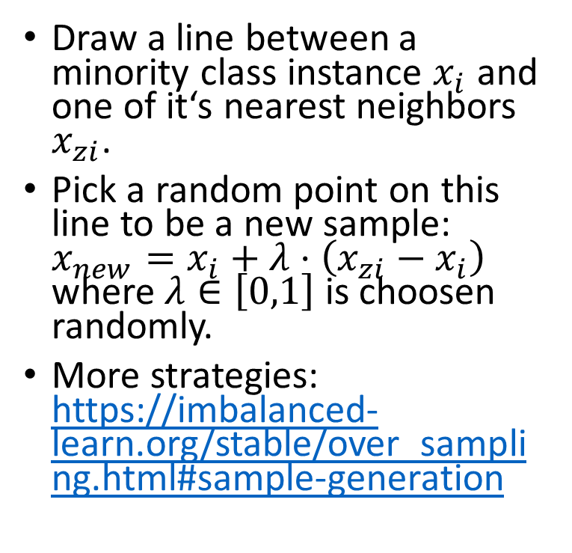



SMOTE
Draw a line between a minority class instance $x_{i}$ and one of it‘s nearest neighbors $x_{zi}$.
Pick a random point on this line to be a new sample: $x_{new}=x_{i}+λ⋅\left(x_{zi}−x_{i}\right)$ where $λ∈\left[0,1\right]$ is choosen randomly.
More strategies: https://imbalanced-learn.org/stable/over_sampling.html#sample-generation
$$x_{i}$$
$$x_{new}$$
$$x_{zi}$$

Slide 6
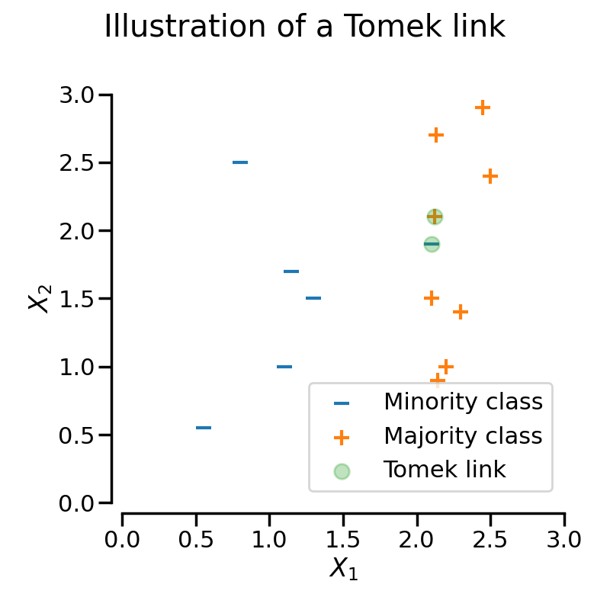
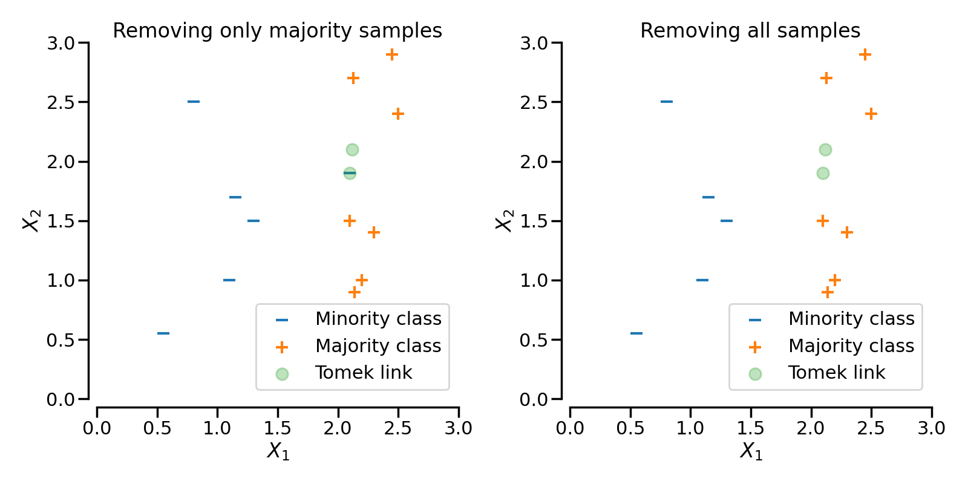
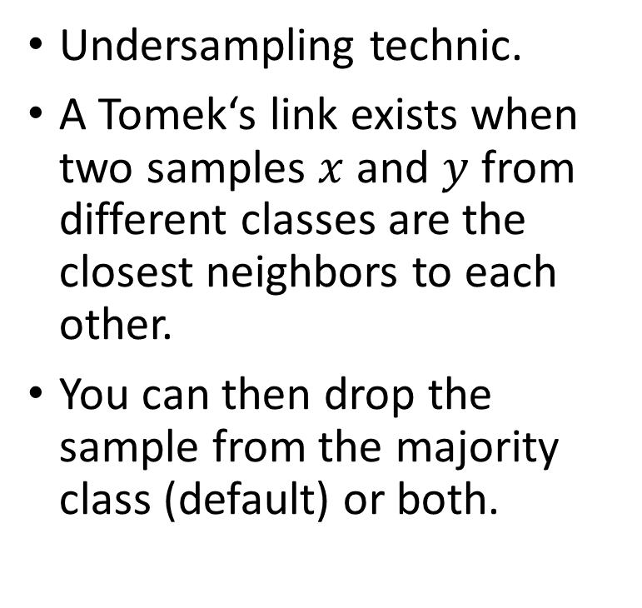
Tomek Links
Undersampling technic.
A Tomek‘s link exists when two samples $x$ and $y$ from different classes are the closest neighbors to each other.
You can then drop the sample from the majority class (default) or both.
sampling_strategy=‘auto‘
sampling_strategy=‘all‘

Slide 7
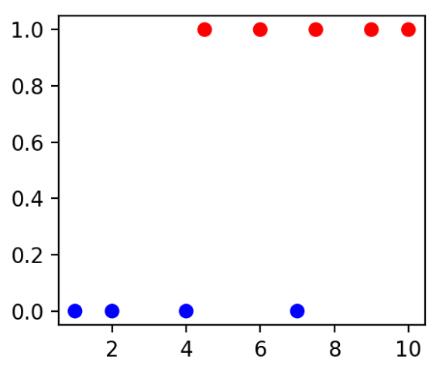
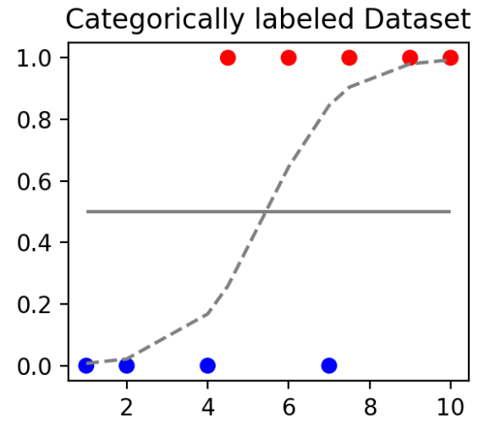
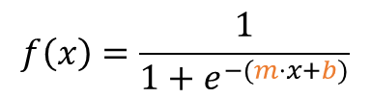

Logistic Regression
Model for binary classification.
Estimates the probability of an outcome.
Uses the logistic function
Feature x | Target
1 | B
2 | B
4 | B
7 | B
4.5 | R
6 | R
7.5 | R
9 | R
10 | R
$$f\left(x\right)=\frac{1}{1+e^{−(m⋅x+b)}}$$
Logistic
Regression
$$f(5)=0,4$$
d.h. ein Sample mit feature (5) Hat die Wahrscheinlich 40% z ur Klasse R. Also ordnen wir das Sample zu Klasse B zu, weil die Wahrscheinlichkeit unter 50% liegt

Slide 8
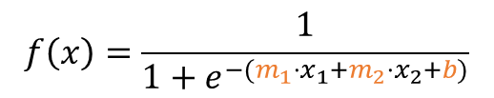
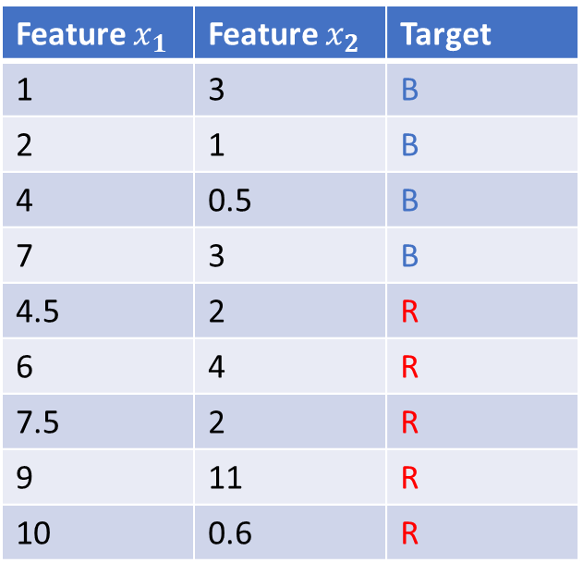
Multiple Features
I we have multiple features we have a polynom with more indipendent variables.
Feature $x_{1}$ | Feature $x_{2}$ | Target
1 | 3 | B
2 | 1 | B
4 | 0.5 | B
7 | 3 | B
4.5 | 2 | R
6 | 4 | R
7.5 | 2 | R
9 | 11 | R
10 | 0.6 | R
$$f\left(x\right)=\frac{1}{1+e^{−(m_{1}⋅x_{1}+m_{2}⋅x_{2}+b)}}$$

Slide 9
Zielsetzung
Datensatz: features, Target: Klasse
Features -> wahrscheinlichkeit für jede Klasse
Samlple: [1,3,2] -> 65% Klasse 1, 35% Klasse 2 -> Klasse 1

Slide 10
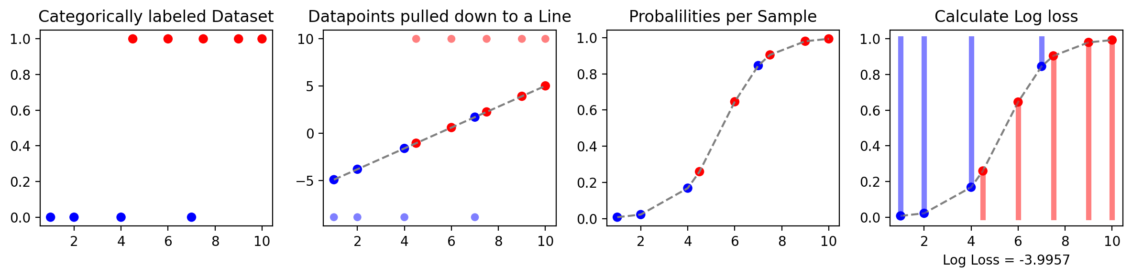
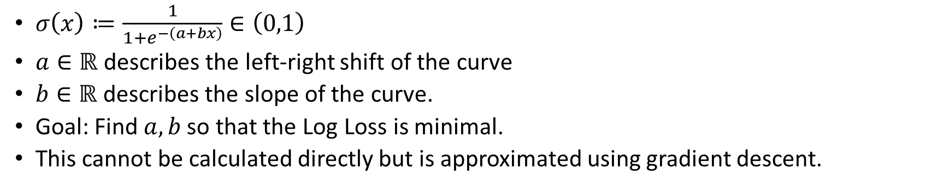
Logistic (Sigmoid) Function
$σ\left(x\right)≔\frac{1}{1+e^{−\left(a+bx\right)}}∈\left(0,1\right)$
$a∈ℝ$ describes the left-right shift of the curve
$b∈ℝ$ describes the slope of the curve.
Goal: Find $a,b$ so that the Log Loss is minimal.
This cannot be calculated directly but is approximated using gradient descent.

Slide 11
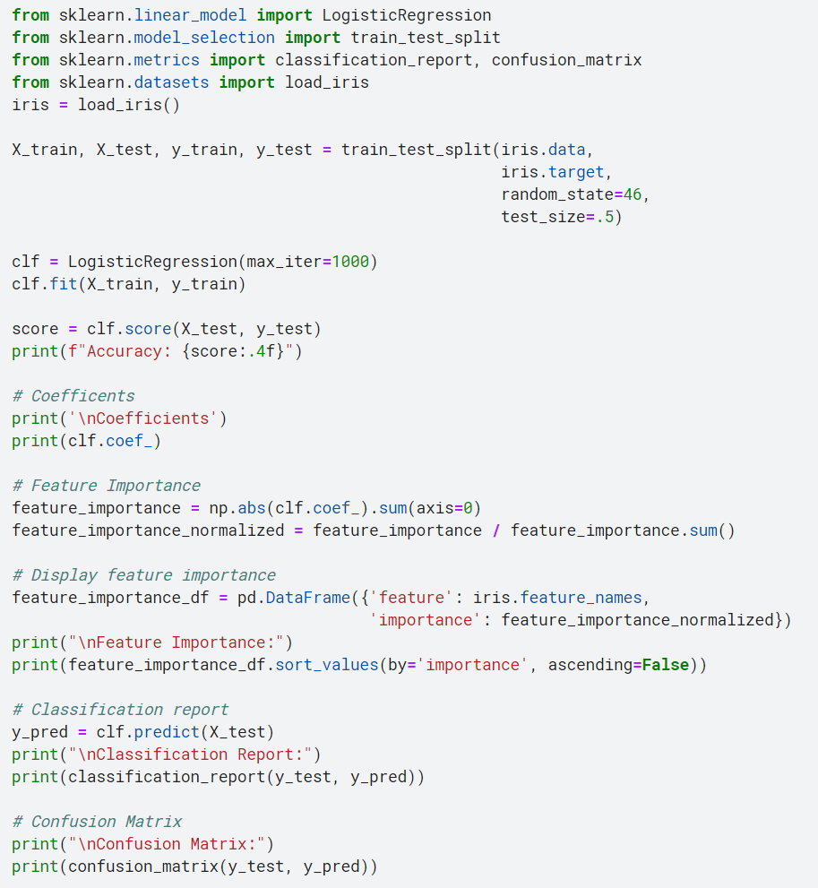
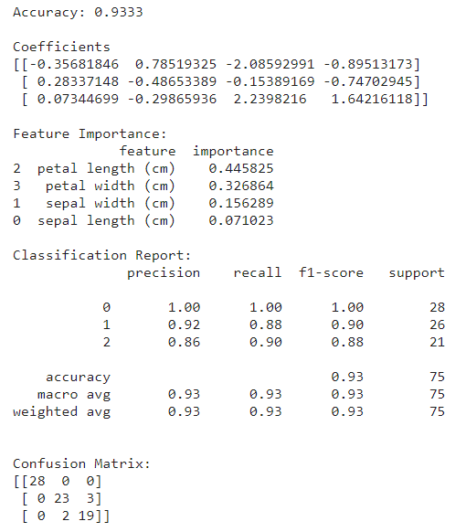
Example
3 groups = 3 different logistic functions

Slide 12

Example
https://www.kaggle.com/viktorreichert/imbalance

Slide 13
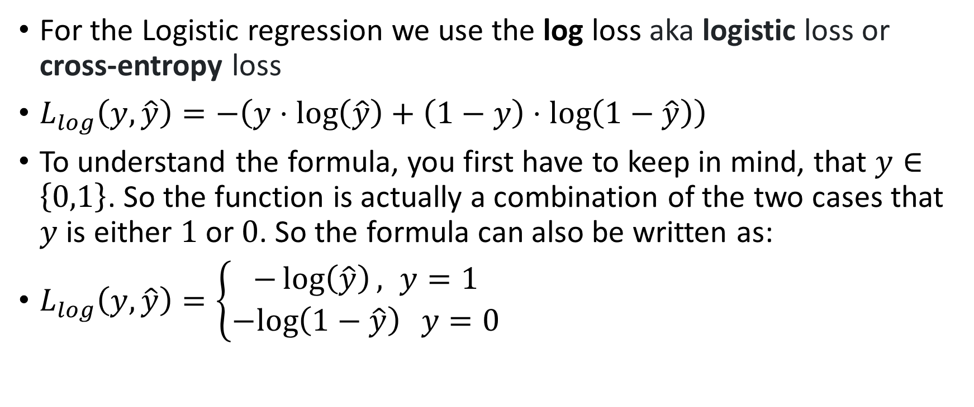
Log Loss
For the Logistic regression we use the log loss aka logistic loss or cross-entropy loss
$L_{log}\left(y,\hat{y}\right)=−\left(y⋅\log\left(\hat{y}\right)+\left(1−y\right)⋅\log\left(1−\hat{y}\right)\right)$
To understand the formula, you first have to keep in mind, that $y∈\left\{0,1\right\}$. So the function is actually a combination of the two cases that $y$ is either $1$ or $0$. So the formula can also be written as:
$L_{log}\left(y,\hat{y}\right)=\left\{\begin{aligned}−\log\left(\hat{y}\right), y=1 \\ &−log\left(1−\hat{y}\right) y=0\end{aligned}\right.$

Slide 14
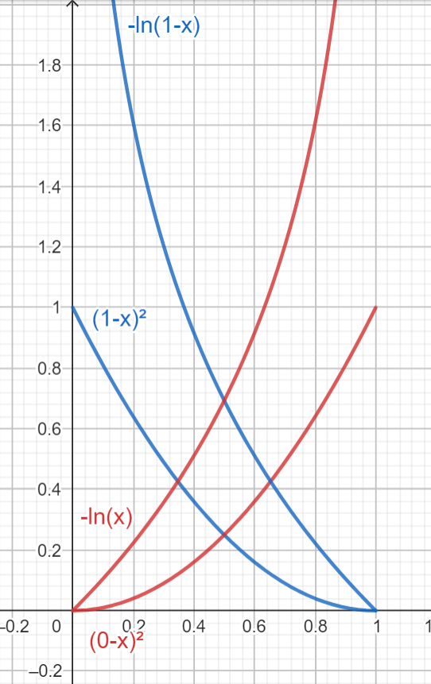
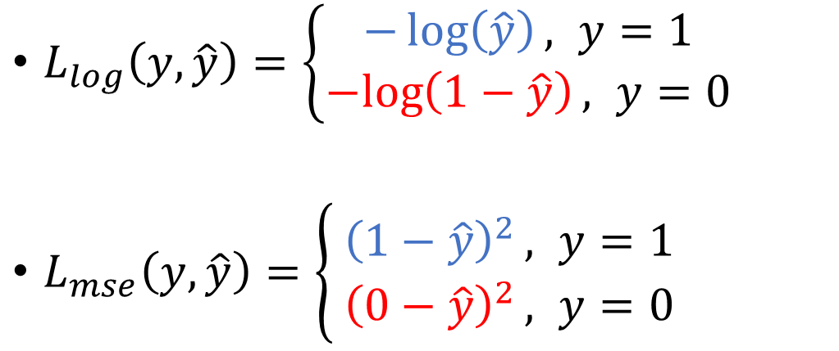
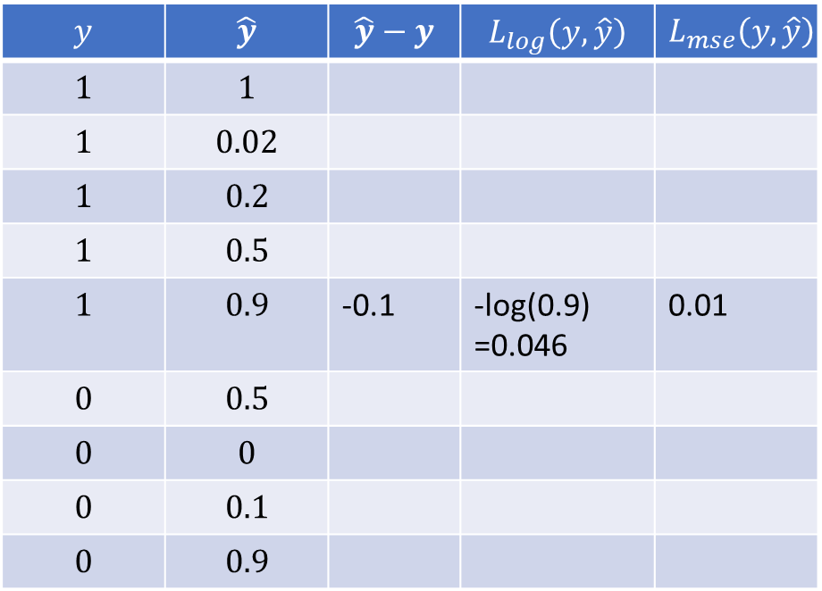
$L_{log}\left(y,\hat{y}\right)=\left\{\begin{aligned}−\log\left(\hat{y}\right), y=1 \\ &−log\left(1−\hat{y}\right), y=0\end{aligned}\right.$
$L_{mse}\left(y,\hat{y}\right)=\left\{\begin{aligned}{{\left(1−\hat{y}\right)}^{2}}, y=1 \\ &{{\left(0−\hat{y}\right)}^{2}}, y=0\end{aligned}\right.$
$$y$$ | $$\hat{y}$$ | $$\hat{y}−y$$ | $$L_{log}\left(y,\hat{y}\right)$$ | $$L_{mse}\left(y,\hat{y}\right)$$
$$1$$ | $$1$$
$$1$$ | $$0.02$$
$$1$$ | $$0.2$$
$$1$$ | $$0.5$$
$$1$$ | $$0.9$$ | -0.1 | -log(0.9) =0.046 | 0.01
$$0$$ | $$0.5$$
$$0$$ | $$0$$
$$0$$ | $$0.1$$
$$0$$ | $$0.9$$
Notes:
https://www.geogebra.org/calculator/adyrhg8y

Slide 15
Website 1: Geologen.de: 90% korrekte Wettervorhersage. 9:1 = 1:1/9
Website 2: StudiMisst.de 50% korrekte Wettervorhersage. 1:1
Website 3: KinderkartenLaboeWetterProjekt.info 10% korrekte Wettervorhersage. 1:9

Slide 16
Jemand besteht mit einer Wahrscheinlichkeit von 70%.
Wenn er noch einen Tag übt, dann verdoppelt sich seine Chance, dass er besteht.
Wie hoch ist die Wahrscheinlichkeit, dass er besteht, wenn er noch einen Tag übt?
70% -> 7:3 -> verdoppeln -> 14:3 -> 14/17 = 83,5%

Slide 17
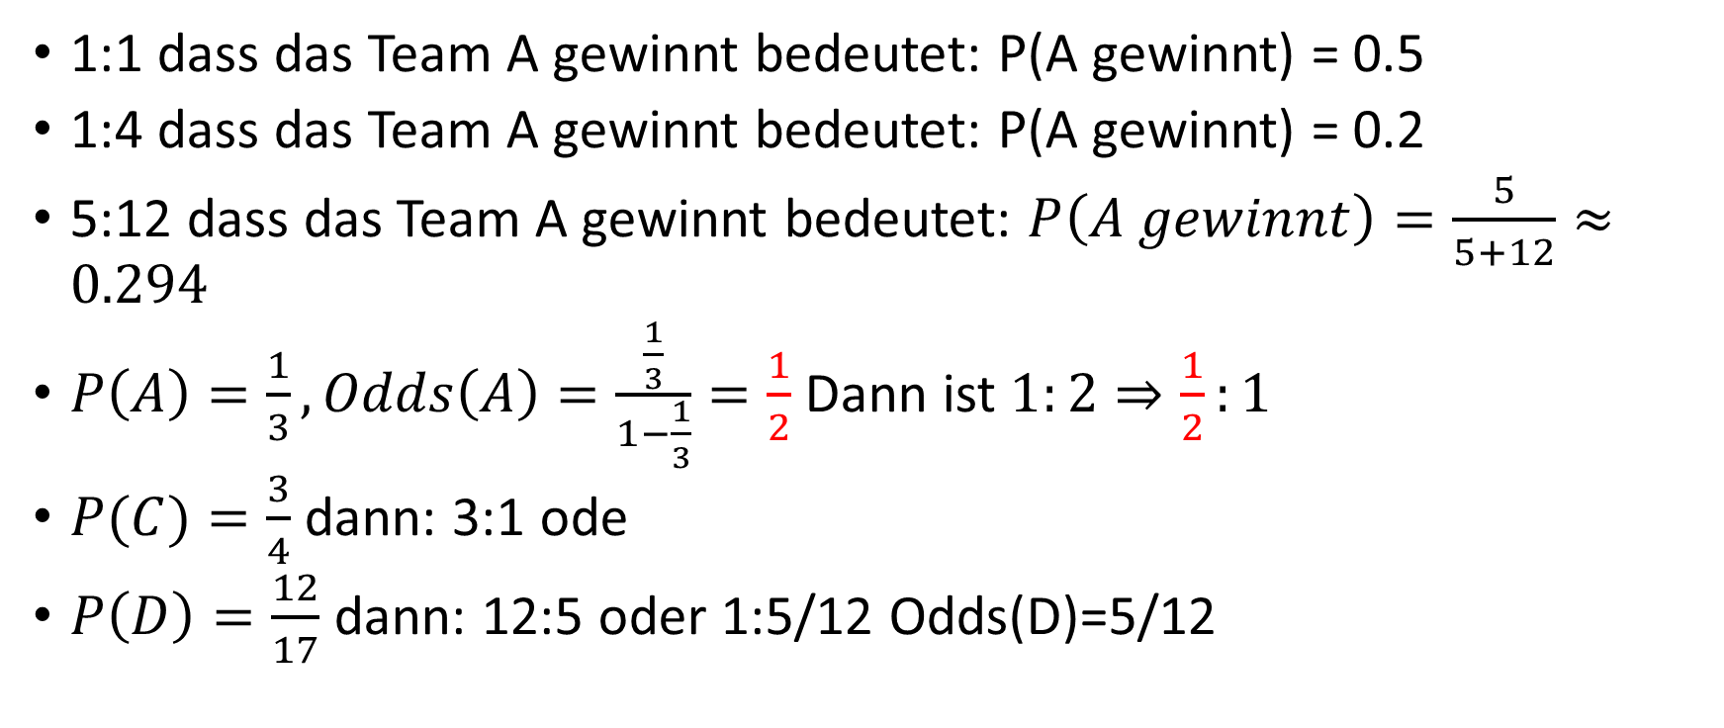
Odds vs. Probabilits
1:1 dass das Team A gewinnt bedeutet: P(A gewinnt) = 0.5
1:4 dass das Team A gewinnt bedeutet: P(A gewinnt) = 0.2
5:12 dass das Team A gewinnt bedeutet: $P\left(A gewinnt\right)=\frac{5}{5+12}≈0.294$
$P\left(A\right)=\frac{1}{3}, Odds\left(A\right)=\frac{\frac{1}{3}}{1−\frac{1}{3}}=\frac{1}{2}$ Dann ist $1:2⇒\frac{1}{2}:1$
$P(C)=\frac{3}{4}$ dann: 3:1 ode
$P\left(D\right)=\frac{12}{17}$ dann: 12:5 oder 1:5/12 Odds(D)=5/12

Slide 18
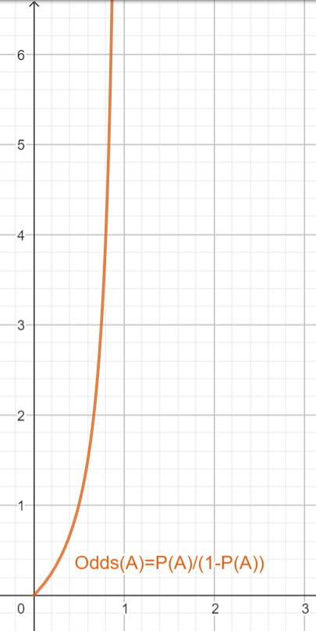
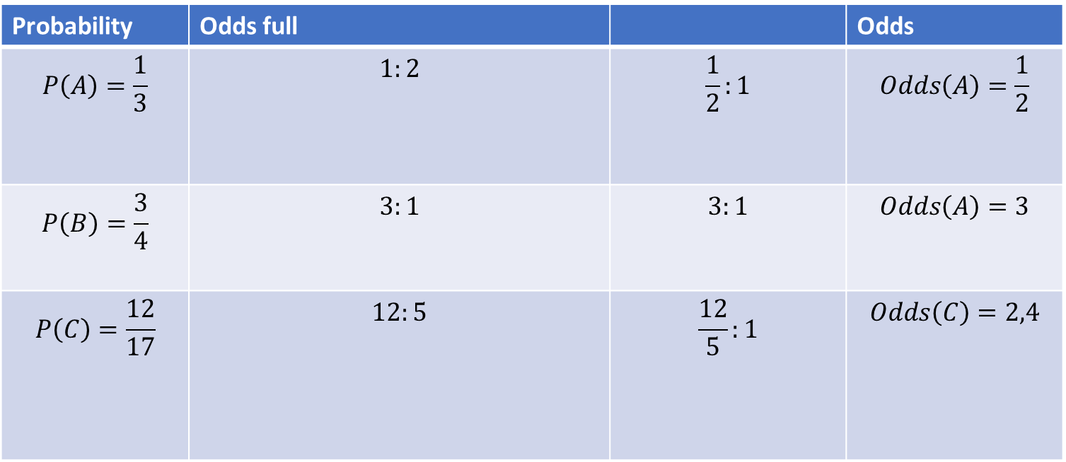

Probability to Odds
Probability | Odds full |  | Odds
$$P\left(A\right)=\frac{1}{3}$$ | $$1:2$$ | $$\frac{1}{2}:1$$ | $$Odds\left(A\right)=\frac{1}{2}$$
$$P\left(B\right)=\frac{3}{4}$$ | $$3:1$$ | $$3:1$$ | $$Odds\left(A\right)=3$$
$$P\left(C\right)=\frac{12}{17}$$ | $$12:5$$ | $$\frac{12}{5}:1$$ | $$Odds\left(C\right)=2,4$$
$$Odds\left(A\right)=\frac{P\left(A\right)}{1−P\left(A\right)}$$

Slide 19
Index | Sevice Zuletzt genutzt
1 | 12.1.23
2 | 23.12.23
3 | 9.12.23
Rechnung erstellt
n
y
n
n
y
n
Löschen
n
n
y
y
n
y
Thread 1
Rechnungen erstellen
😀
😀
😀
😀
4
😀
😀
😀
😀
😀
Thread 2
Altkunden löschen
😀
4

Slide 20
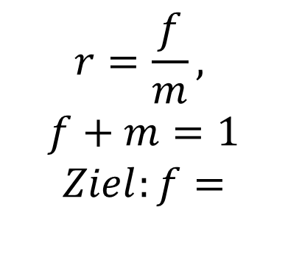

$r=\frac{f}{1−f}$
$⇒r⋅\left(1−f\right)=f$
$⇒\frac{1−f}{f}=\frac{1}{r}$
$⇒\frac{1}{f}−1=\frac{1}{r}$
$⇒\frac{1}{f}=\frac{1}{r}+1$
$⇒f=\frac{1}{\frac{1}{r}+1}=\frac{1}{\frac{1+r}{r}}=\frac{r}{1+r}$
$$r=\frac{f}{m},$$
$$f+m=1$$
$$Ziel:f=$$

Slide 21


r
$$r:1$$
$$p=\frac{r}{r+1}$$
r
1
r
1

Slide 23
40 h * 0.25 = 10h
mean(orange) = 0,25

Slide 24
40 h * 0.25 = 10h
mean(orange) = 0,25

